Slide 1
5
APPLICATIONS OF INTEGRATION
Copyright © Cengage Learning. All rights reserved.

Slide 2
5.4
Arc Length
Copyright © Cengage Learning. All rights reserved.

Slide 3
Arc Length
We are going to define the length of a general curve by first approximating it by a polygon and then taking a limit as the number of segments of the polygon is increased.
Now suppose that a curve C is defined by the equation y = f (x), where f is continuous and a ≤ x ≤ b.
We obtain a polygonal approximation to C by dividing the interval [a, b] into n subintervals with endpoints x₀, x₁, x₂, …, x_{n} and equal width Δx.

Slide 4
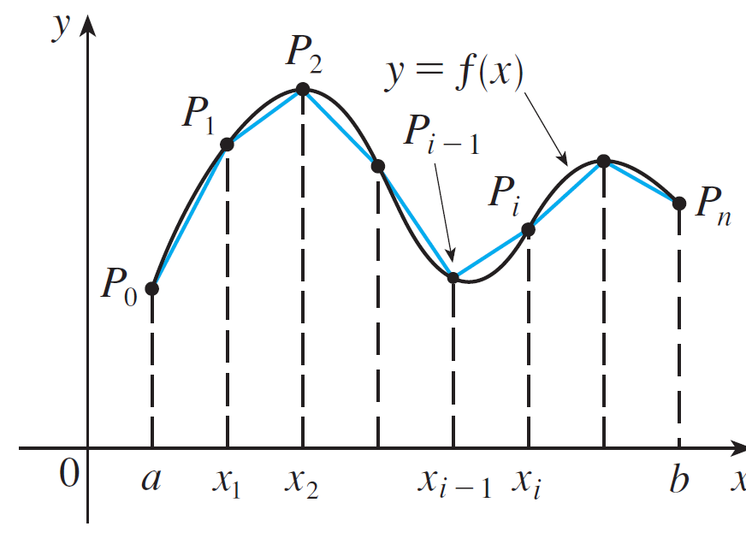
Arc Length
If y_{i} = f (x_{i}), then the point P(x_{i}, y_{i}) lies on C and the polygon with vertices P₀, P₁, …. , P_{n}, illustrated in Figure 3, is an approximation to C.
Figure 3

Slide 5
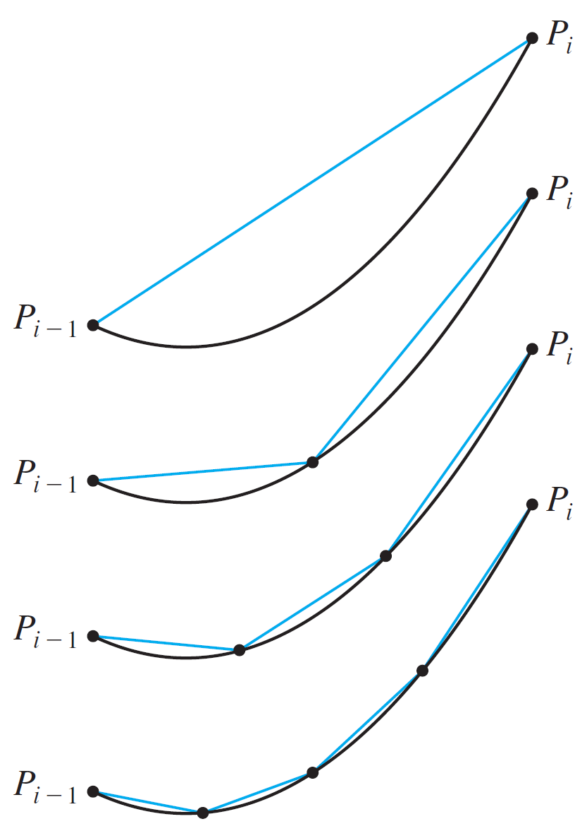
Arc Length
The length L of C is approximately the length of this polygon and the approximation gets better as we let n increase.
(See Figure 4, where the arc
of the curve between P_{i –1} and P_{i}
has been magnified and
approximations with successively
smaller values of Δx are shown.)
Figure 4

Slide 6
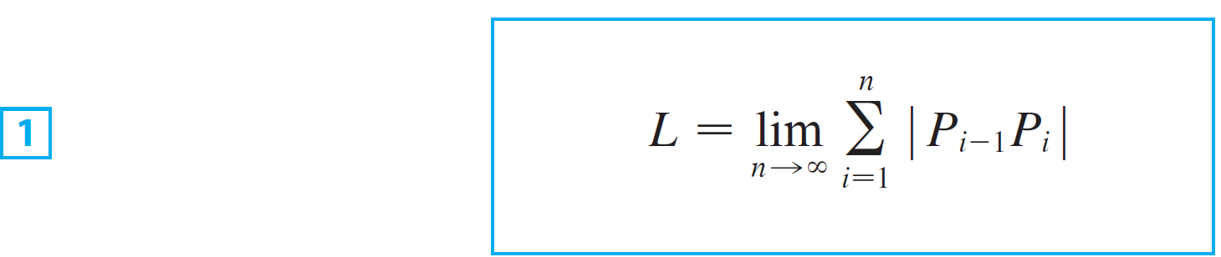

Arc Length
Therefore we define the length L of C the curve with equation y = f (x), a ≤ x ≤ b, as the limit of the lengths of these inscribed polygons (if the limit exists):
We divided the curve into a large number of small parts. We then found the approximate lengths of the small parts and added them. Finally, we took the limit as .

Slide 7

Arc Length
We can derive an integral formula for L in the case where f has a continuous derivative. [Such a function f is called smooth because a small change in x produces a small change in f ′(x).]
If we let , then

Slide 8




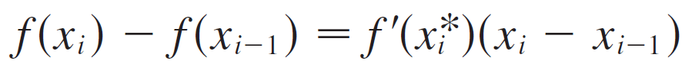

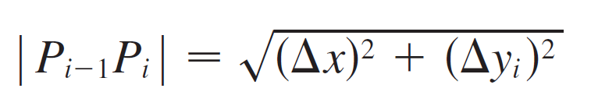
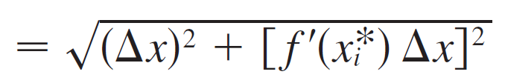
Arc Length
By applying the Mean Value Theorem to f on the interval
, we find that there is a number between and
such that
that is,
Thus we have

Slide 9
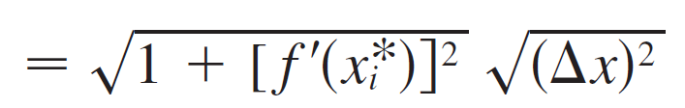
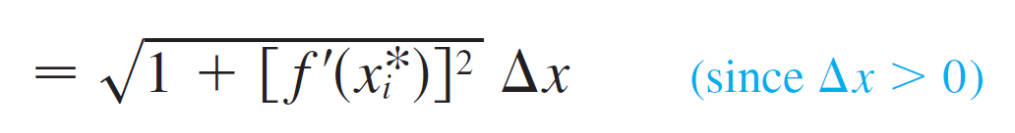
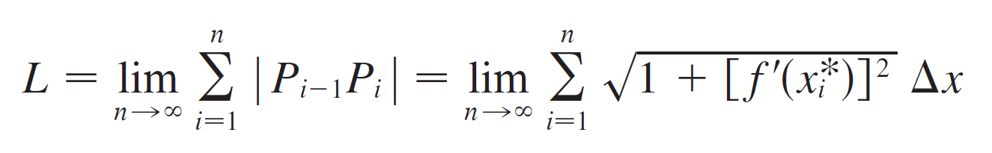
Arc Length
Therefore, by Definition 1,

Slide 10
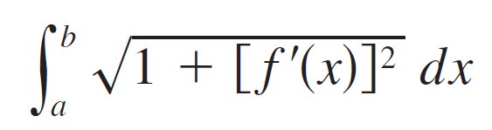

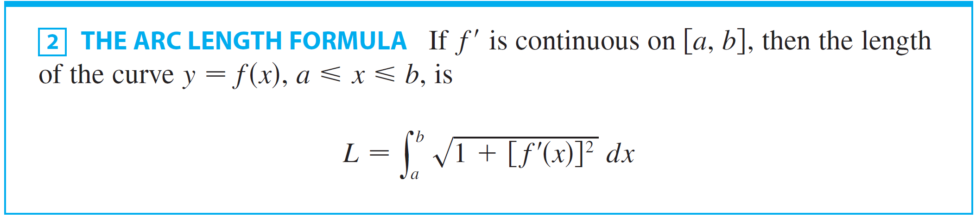
Arc Length
We recognize this expression as being equal to
by the definition of a definite integral. This integral exists because the function is is continuous. Thus we have proved the following theorem:

Slide 11
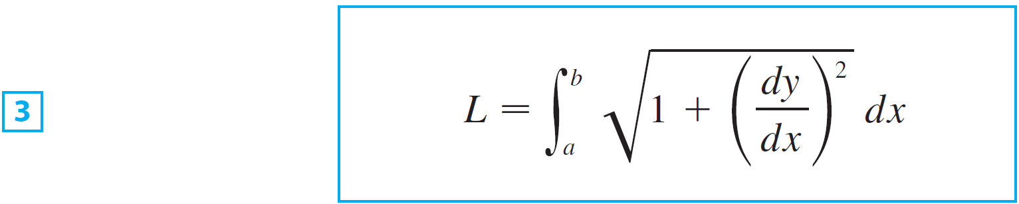
Arc Length
If we use Leibniz notation for derivatives, we can write the arc length formula as follows:

Slide 12
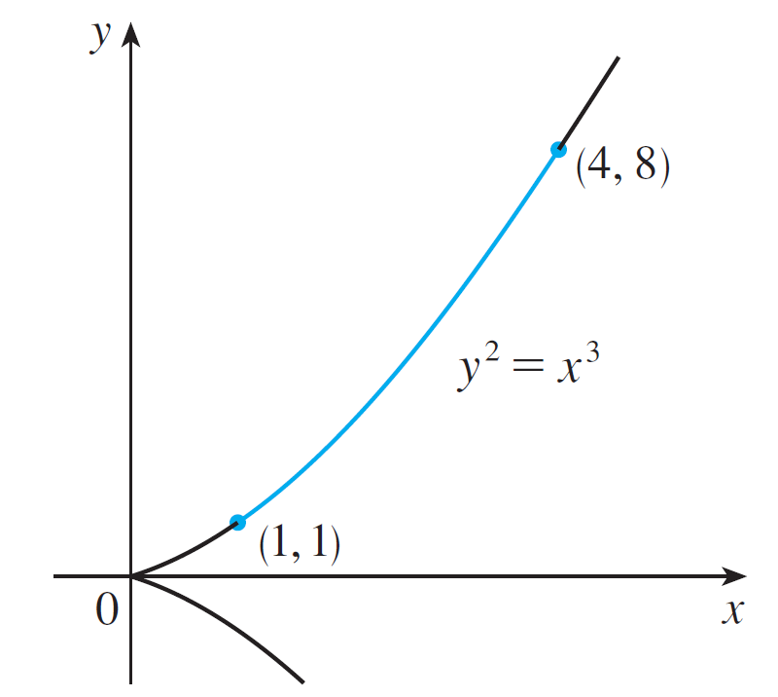
Example 1
Find the length of the arc of the semicubical parabola y² = x³ between the points (1, 1) and (4, 8). (See Figure 5.)
Figure 5

Slide 13
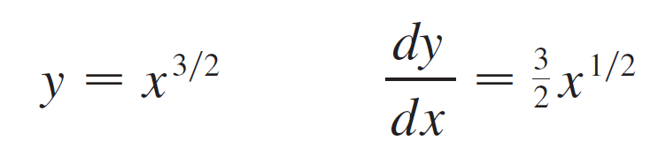
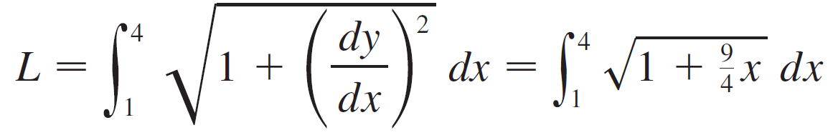
Example 1 – Solution
For the top half of the curve we have
and so the arc length formula gives

Slide 14



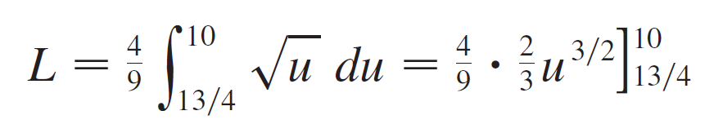
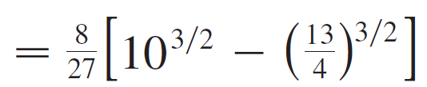
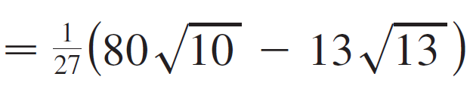
Example 1 – Solution
cont’d
If we substitute , then .
When x = 1, ; when x = 4, u = 10.
Therefore

Slide 15
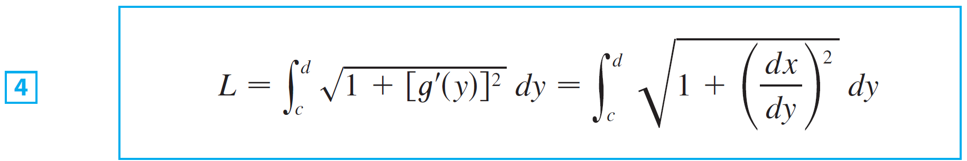
Arc Length
If a curve has the equation x = g(y), c ≤ y ≤ d, and g ′(y) is continuous, then by interchanging the roles of x and y in Formula 2 or Equation 3, we obtain the following formula for its length:

Slide 16
Arc Length
Because of the presence of the square root sign in Formulas 2 and 4, the calculation of an arc length often leads to an integral that is very difficult or even impossible to evaluate explicitly.
Thus we sometimes have to be content with finding an approximation to the length of a curve as in the next example.

Slide 17

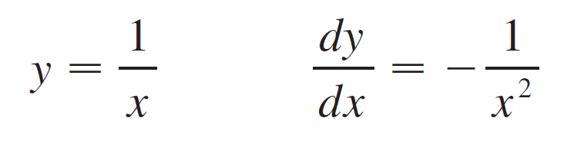
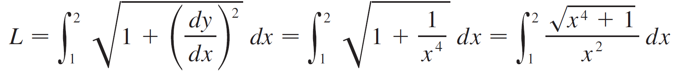
Example 3
(a) Set up an integral for the length of the arc of the hyperbola xy = 1 from the point (1, 1) to the point .
(b) Use Simpson’s Rule with n = 10 to estimate the arc length.
Solution:
(a) We have
and so the arc length is

Slide 18

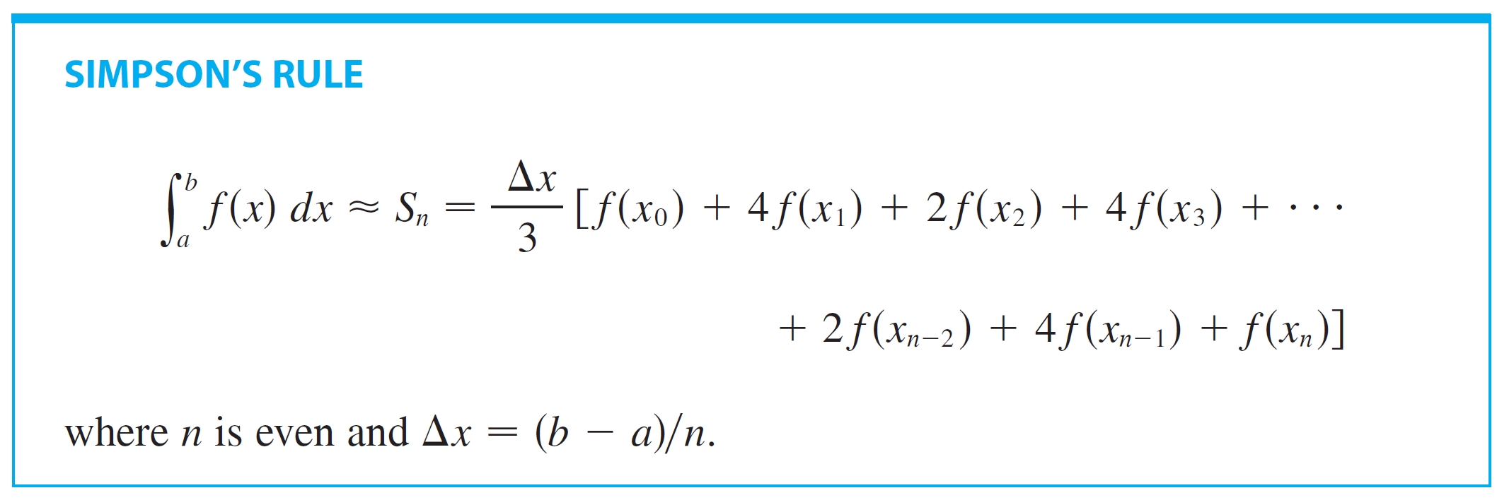
Example 3 – Solution
cont’d
(b) Using Simpson’s Rule with a = 1, b = 2, n = 10,
Δx = 0.1, and ,

Slide 19
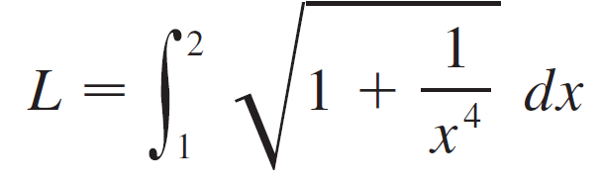

Example 3 – Solution
cont’d
We have

Slide 20
The Arc Length Function

Slide 21
The Arc Length Function
We will find it useful to have a function that measures the arc length of a curve from a particular starting point to any other point on the curve.
Thus if a smooth curve C has the equation y = f (x), a ≤ x ≤ b, let s(x) be the distance along C from the initial point P₀(a, f (a)) to the point O(x, f (x)).

Slide 22
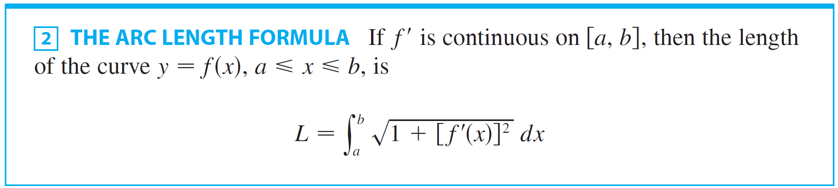
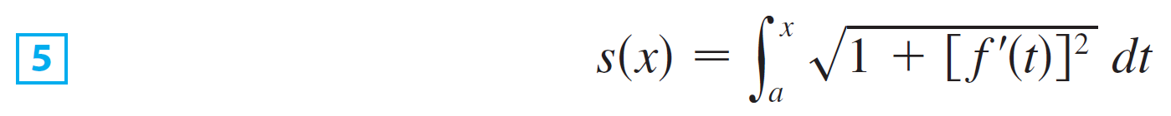
The Arc Length Function
Then is a function, called the arc length function, and, by Formula 2,

Slide 23


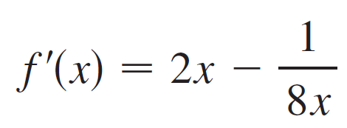
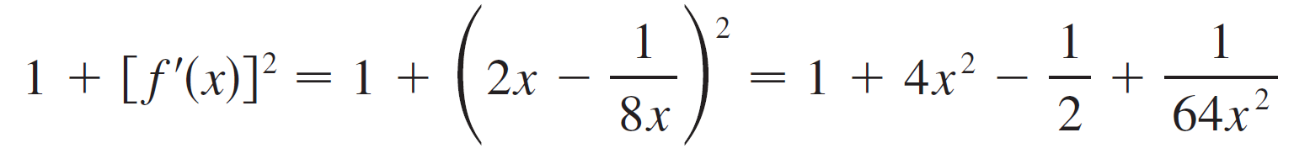
Example 4
Find the arc length function for the curve taking P₀(1, 1) as the starting point.
Solution:
If , then

Slide 24
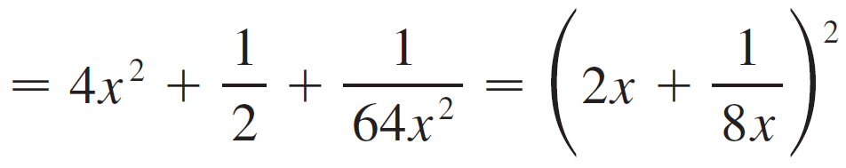
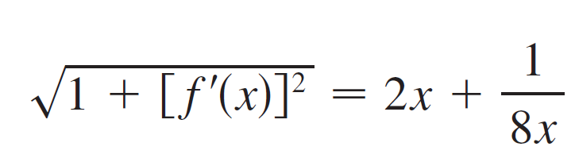
Example 4 – Solution
cont’d

Slide 25
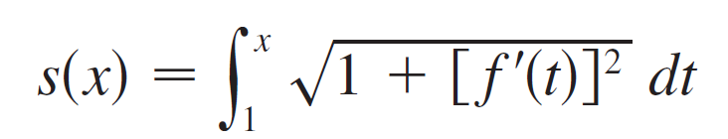
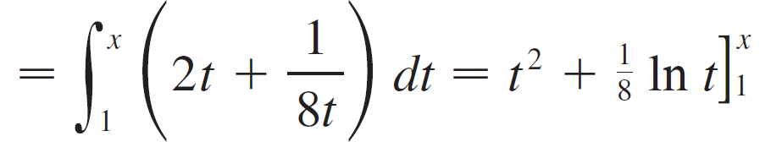

Example 4 – Solution
cont’d
Thus the arc length function is given by

Slide 26

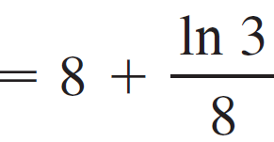
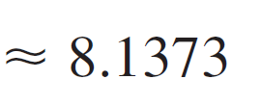
Example 4 – Solution
cont’d
For instance, the arc length along the curve from (1, 1) to (3, f (3)) is

Slide 27
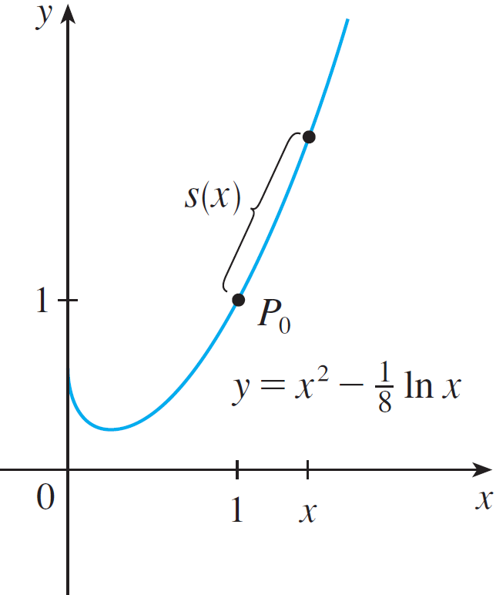
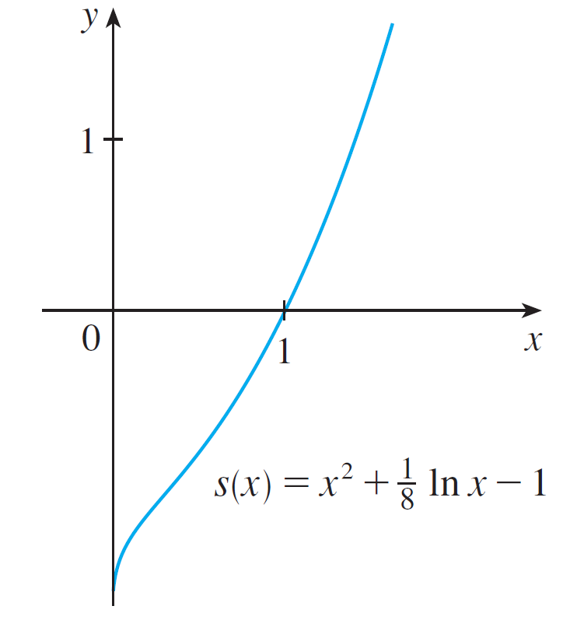
The Arc Length Function
Figure 8 shows the interpretation of the arc length function in Example 4.
Figure 9 shows the graph of this arc length function.
Figure 8
Figure 9

